Slide 1
Frequency distribution and Chart Building

Slide 2
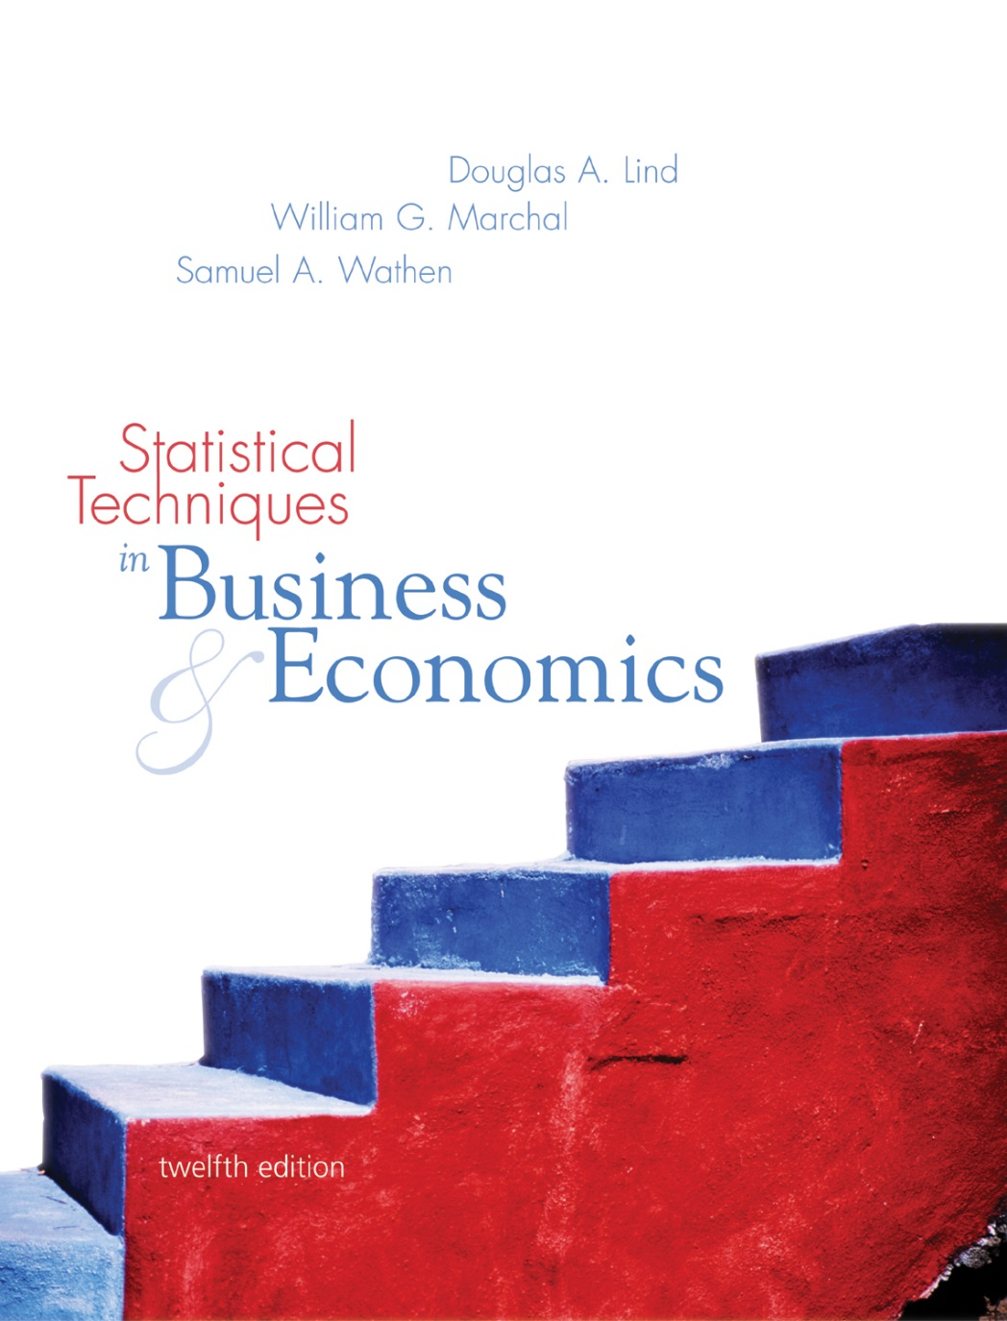
Chapter
Two
McGraw-Hill/Irwin
© 2005 The McGraw-Hill Companies, Inc., All Rights Reserved.

Slide 3
Goals
Chapter Two
Describing Data: Frequency Distributions and Graphic Presentation
GOALS
When you have completed this chapter, you will be able to:
ONE Organize data into a frequency distribution.
TWO Portray a frequency distribution in a histogram, frequency polygon, and cumulative frequency polygon.
THREE Present data using such graphic techniques as line charts, bar charts, and pie charts.

Slide 4
Frequency Distribution
A Frequency Distribution is a grouping of data into mutually exclusive categories showing the number of observations in each class.

Slide 5
Constructing a frequency distribution
Constructing a frequency distribution involves:
Determining the question to be addressed

Slide 6
Constructing a frequency distribution
Constructing a frequency distribution involves:
Collecting raw data
Determining the question to be addressed

Slide 7
Constructing a frequency distribution
Constructing a frequency distribution involves:
Organizing data (frequency distribution)
Collecting raw data
Determining the question to be addressed

Slide 8
Constructing a frequency distribution
Constructing a frequency distribution involves:
Presenting data (graph)
Organizing data (frequency distribution)
Collecting raw data
Determining the question to be addressed

Slide 9
Constructing a frequency distribution
Constructing a frequency distribution involves:
Drawing conclusions
Presenting data (graph)
Organizing data (frequency distribution)
Collecting raw data
Determining the question to be addressed

Slide 10
Constructing a frequency distribution
20
Drawing conclusions
Presenting data (graph)
15
Organizing data (frequency distribution)
10
5
Collecting raw data
1.5
3.5
5.5
7.5
9.5
11.5
13.5

Slide 11
Definitions
Class Midpoint: A point that divides a class into two equal parts. This is the average of the upper and lower class limits.
Class interval: The class interval is obtained by subtracting the lower limit of a class from the lower limit of the next class. The class intervals should be equal.
Class Frequency: The number of observations in each class.

Slide 12
EXAMPLE 1
Dr. Tillman is Dean of the School of Business Socastee University. He wishes prepare to a report showing the number of hours per week students spend studying. He selects a random sample of 30 students and determines the number of hours each student studied last week.
15.0, 23.7, 19.7, 15.4, 18.3, 23.0, 14.2, 20.8, 13.5, 20.7, 17.4, 18.6, 12.9, 20.3, 13.7, 21.4, 18.3, 29.8, 17.1, 18.9, 10.3, 26.1, 15.7, 14.0, 17.8, 33.8, 23.2, 12.9, 27.1, 16.6.
Organize the data into a frequency distribution.

Slide 13
Example 1 continued
Step One: Decide on the number of classes using the formula
2^{k} > n
where k=number of classes
n=number of observations
There are 30 observations so n=30.
Two raised to the fifth power is 32.
Therefore, we should have at least 5 classes, i.e., k=5.

Slide 14
Example 1 continued
Step Two: Determine the class interval or width using the formula
H – L
k
33.8 – 10.3
5
i >
=
= 4.7
where H=highest value, L=lowest value
Round up for an interval of 5 hours.
Set the lower limit of the first class at 7.5 hours, giving a total of 6 classes.

Slide 15
EXAMPLE 1 continued
Step Three: Set the individual class limits and
Steps Four and Five: Tally and count the number of items in each class.

Slide 16
Example 1 continued
Class Midpoint: find the midpoint of each interval, use the following formula:
Upper limit + lower limit
2

Slide 17
Example 1 continued
A Relative Frequency Distribution shows the percent of observations in each class.

Slide 18
Graphic Presentation of a Frequency Distribution
The three commonly used graphic forms are Histograms, Frequency Polygons, and a Cumulative Frequency distribution.
A Histogram is a graph in which the class midpoints or limits are marked on the horizontal axis and the class frequencies on the vertical axis.
The class frequencies are represented by the heights of the bars and the bars are drawn adjacent to each other.

Slide 19
Histogram for Hours Spent Studying
midpoint

Slide 20
Graphic Presentation of a Frequency Distribution
A Frequency Polygon consists of line segments connecting the points formed by the class midpoint and the class frequency.
Graphic Presentation of a Frequency Distribution

Slide 21
Frequency Polygon for Hours Spent Studying
Frequency Polygon for Hours Spent Studying

Slide 22
Cumulative Frequency distribution
Cumulative Frequency Distribution
A Cumulative Frequency Distribution is used to determine how many or what proportion of the data values are below or above a certain value.
To create a cumulative frequency polygon, scale the upper limit of each class along the X-axis and the corresponding cumulative frequencies along the Y-axis.

Slide 23
Cumulative frequency table
Cumulative Frequency Table for Hours Spent Studying

Slide 24
Cumulative Frequency Distribution For Hours Studying
Cumulative frequency distribution

Slide 25
Line Graphs
Line graphs are typically used to show the change or trend in a variable over time.

Slide 26
Example 3 continued

Slide 27
Bar Chart
A Bar Chart can be used to depict any of the levels of measurement (nominal, ordinal, interval, or ratio).
Construct a bar chart for the number of unemployed per 100,000 population for selected cities during 2001

Slide 28
Bar Chart for the Unemployment Data

Slide 29
Pie Chart
A Pie Chart is useful for displaying a relative frequency distribution. A circle is divided proportionally to the relative frequency and portions of the circle are allocated for the different groups.
A sample of 200 runners were asked to indicate their favorite type of running shoe. Draw a pie chart based on the following information.

Slide 30
Pie Chart for Running Shoes
Pie Chart for Running Shoes

